Slide 1
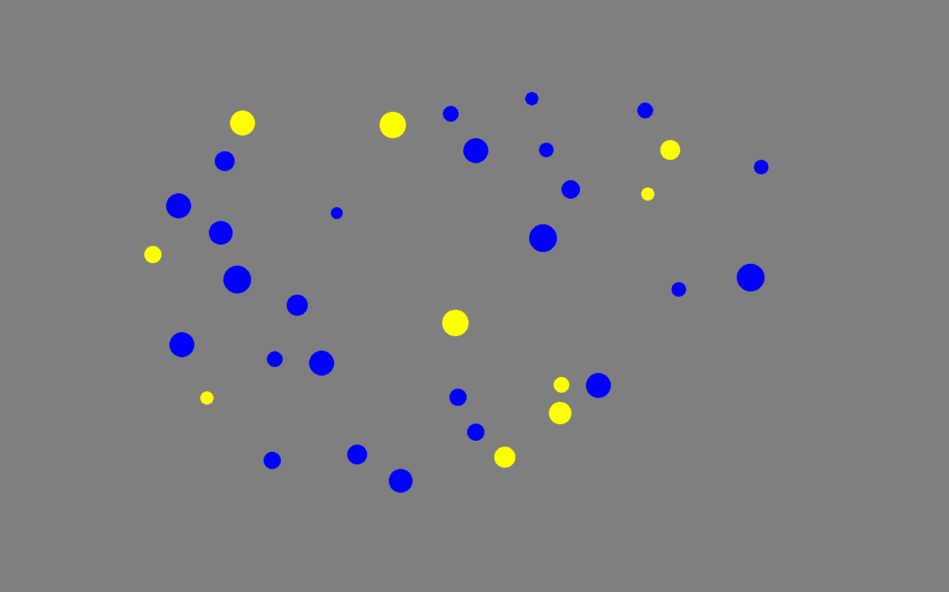
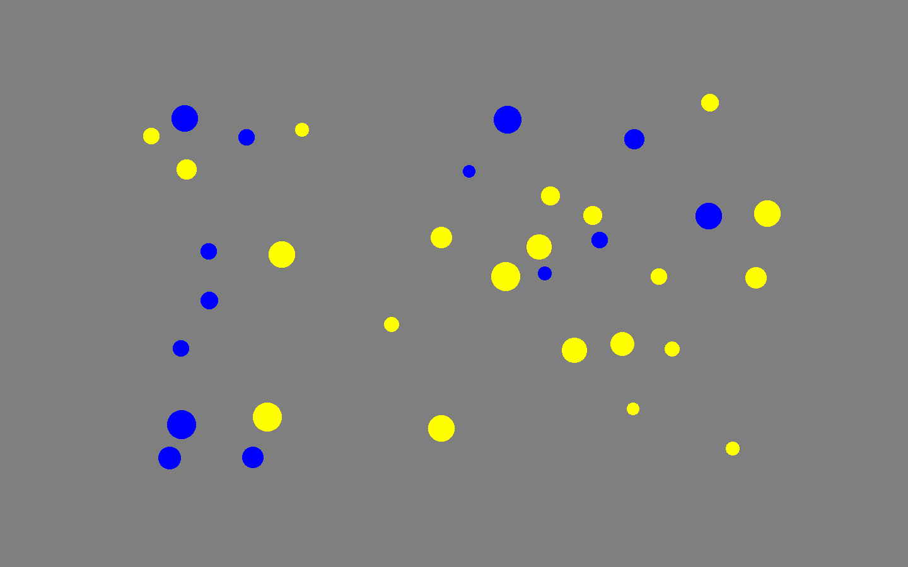
Welcome to the Number Approximation Task.
We appreciate you participating in our experiments today. Please make sure you are seated comfortably. If your experimenter has allowed you to use headphones, please make sure that they are plugged in and working.
In this task, you will see some blue and yellow dots flashed on the screen, much like the pictures below. Your task will be to decide if more of the dots are yellow or blue. If you think that more of the dots are yellow, press the “Z” key. If you think that more of the dots are blue, press the “M” key. The dots will flash quickly and the task is sometimes going to be easy and sometimes it is going to be very hard. Just do your best on each trial. You should answer as quickly as possibly while remaining accurate.
Please press “C” to continue.

Slide 2
Welcome to the Number Approximation Task.
At the beginning of each trial, you will see a fixation (+) in the centre of the screen. Whenever you are ready to start the trial, press SPACEBAR and the trial will immediately start. If you are ever feeling tired and would like to take a break, just don’t press spacebar.
This task should take 5 – 8 minutes (depending on the length of your breaks). After it is done, please find your experimenter. The task will begin right after this screen.
If you have any questions, please ask your experimenter before beginning the task.
When ready, press “B” to begin.

